Slide 1

COVID-19
Group 6

Slide 2

INTRODUCTION

Slide 3
COVID-19
2019–2020
The 2019–20 coronavirus pandemic is an ongoing pandemic of coronavirus disease 2019 (COVID-19) caused by severe acute respiratory syndrome coronavirus 2.
30th Jan. 2020
The World Health Organization declared the outbreak to be a Public Health Emergency of International Concern on January 30, 2020, and recognized it as a pandemic on March 2020.
11th Dec. 2019
The outbreak was identified in Wuhan, China, in December 2019.
20th Apr. 2020
The state of New York has seen over 15,000 deaths, more than any other state. As of April 20, 2020, the U.S. has the most confirmed active cases and deaths in the world.
20th Jan. 2020
The first known case of COVID-19 in the U.S. was confirmed on January 20, 2020, in a 35-year-old person who had returned from Wuhan, China, five days earlier.

Slide 4
ITMD 526 Data Warehousing
Sibo Bai
Shivani Agrawal
Sarthak Agrawal
Vaibhavi Kulkarni
Shreeya Deshpande
Ramakant Sunil Chaudhari

Slide 5
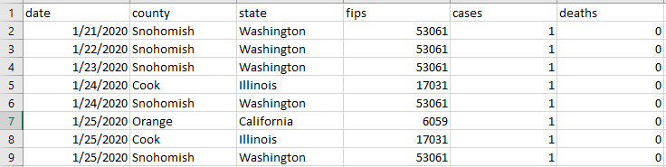
DATA
Tracking Covid-19 cases in the US
Since January, novel coronavirus has spread to nearly every state and territory
The data below is based on data from the Kaggle website
These numbers are updated every 15 minutes, but we have taken data from 21st January to 12th April 2020

Slide 6
CATALOGUE
Data Preparation
Provisioning and Transformation
Dashboard Implementation
Analysis and storytelling of data

Slide 7

Data Preparation

Slide 8

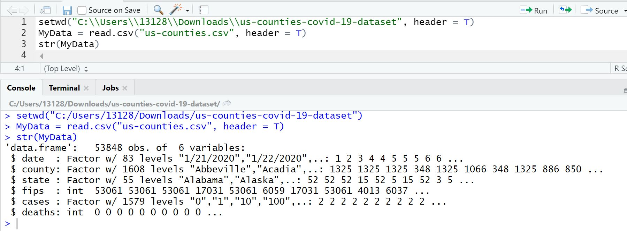
Loading the data from the .csv file and creating a dataframe as mydata

Slide 9
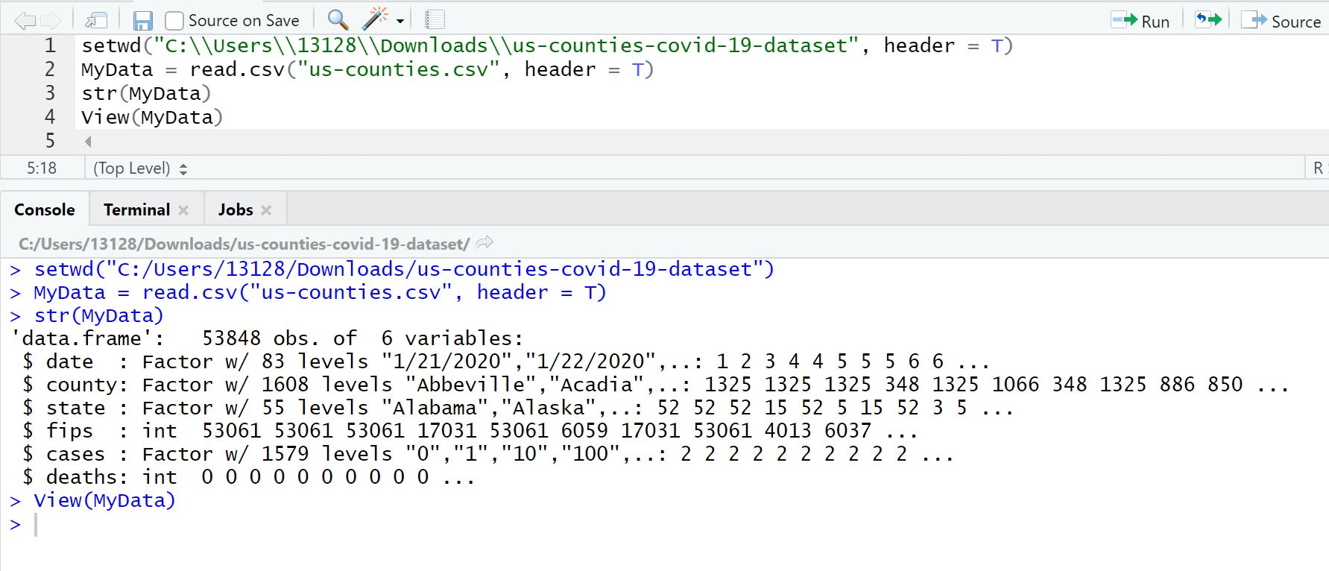
Using ‘view’ we are checking the file

Slide 10
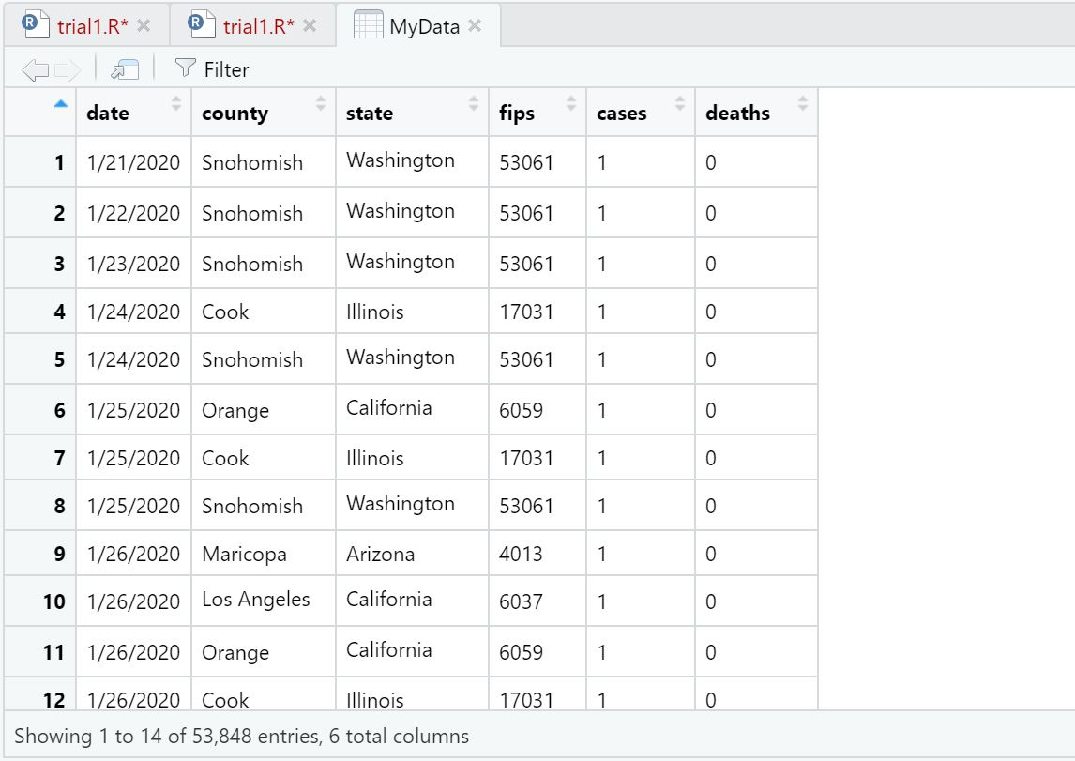
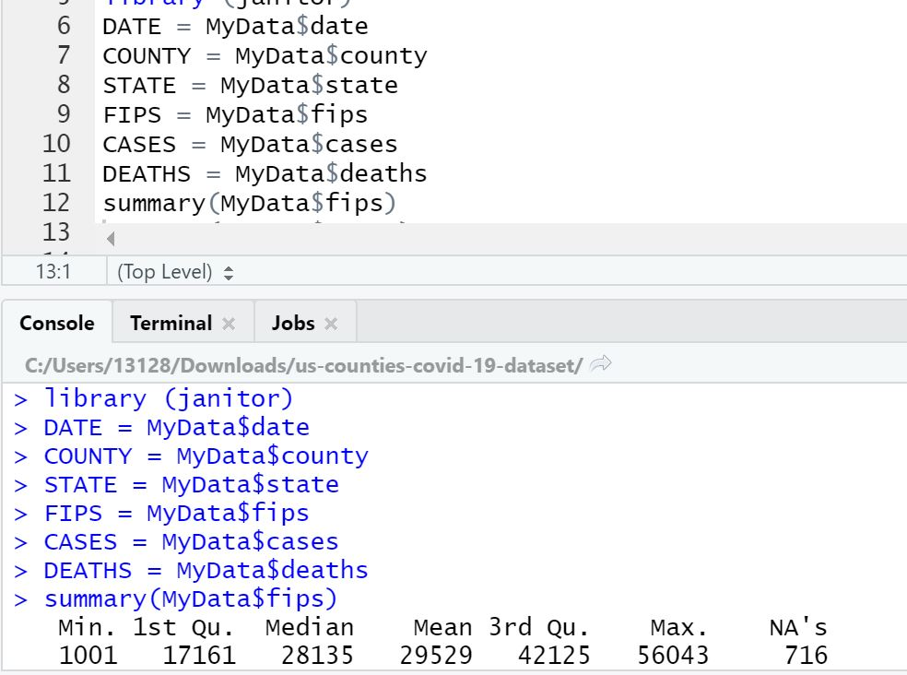
Result of the data

Slide 11
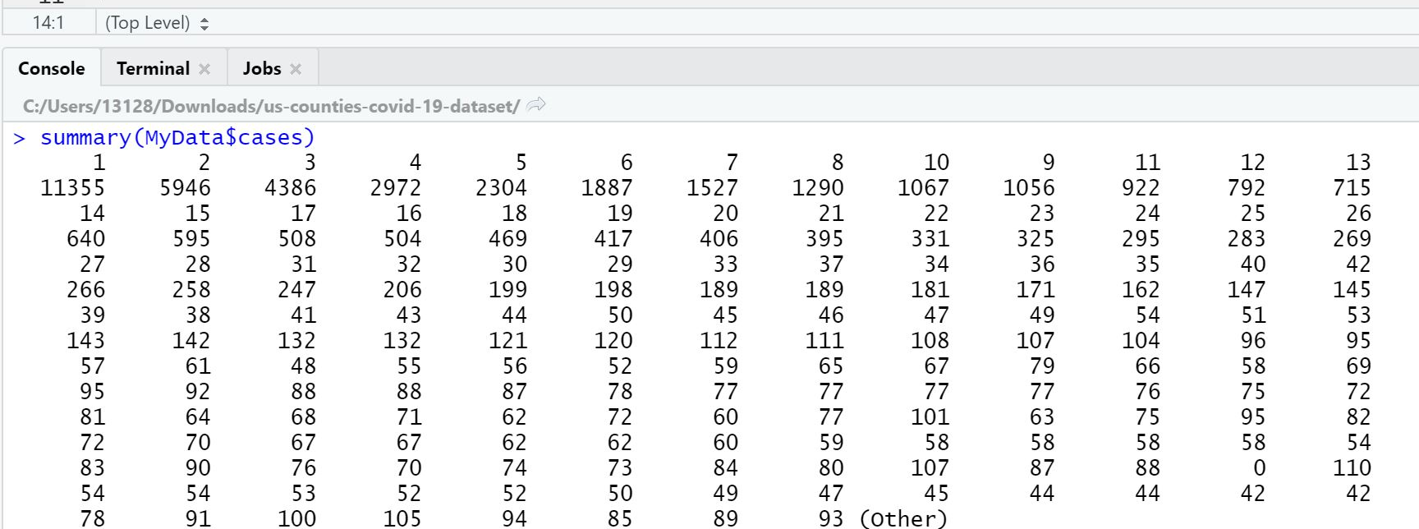
Summary() - To Check if we have any null value

Slide 12
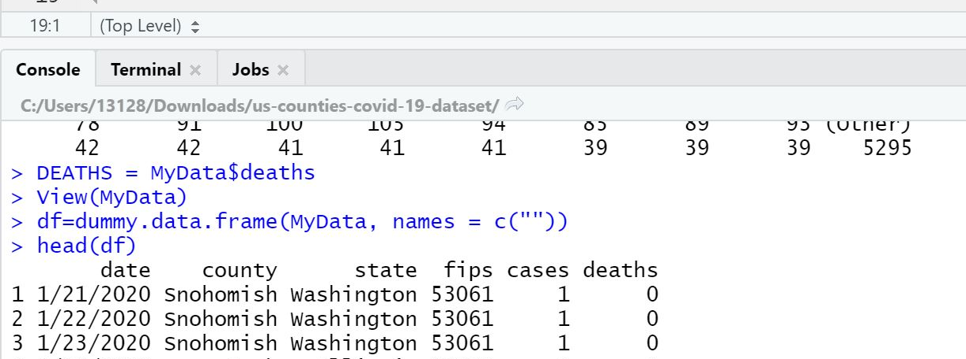
No pre- processing is needed for cases and death column - As we do not see any missing data

Slide 13
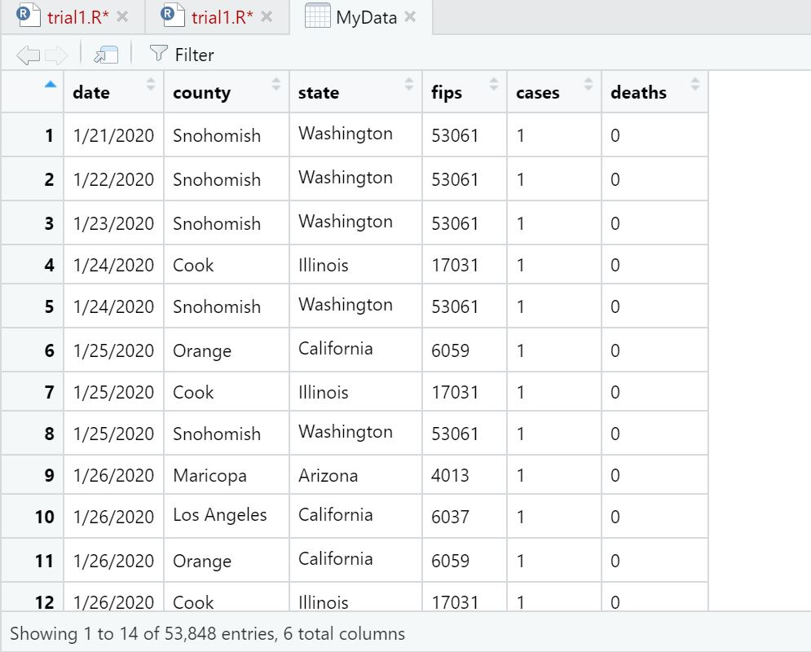
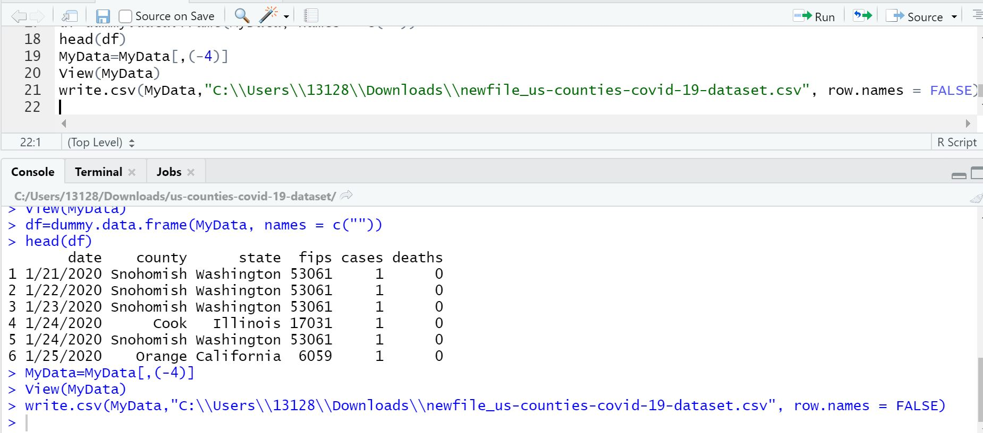
Here, we have eliminated ‘fips’ column as it is of no use and using view() we checked whether it is removed or not
Created new data frame after removing the column

Slide 14
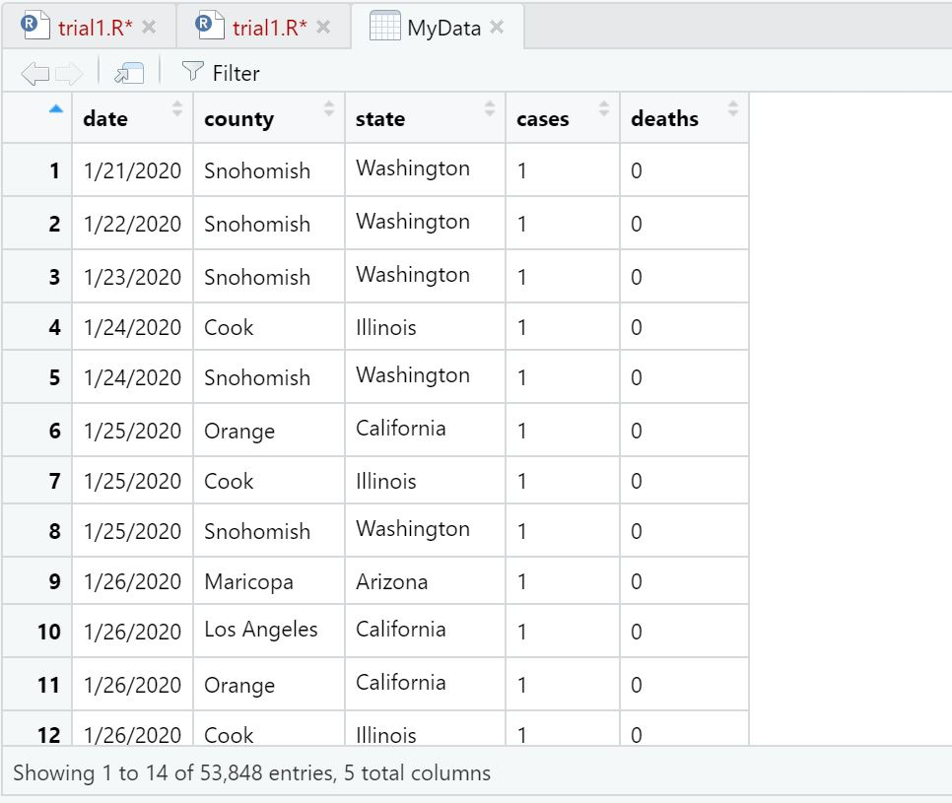
Our final data looks like this

Slide 15

Provisioning and Transformation USING SQLYOG & Pentaho

Slide 16
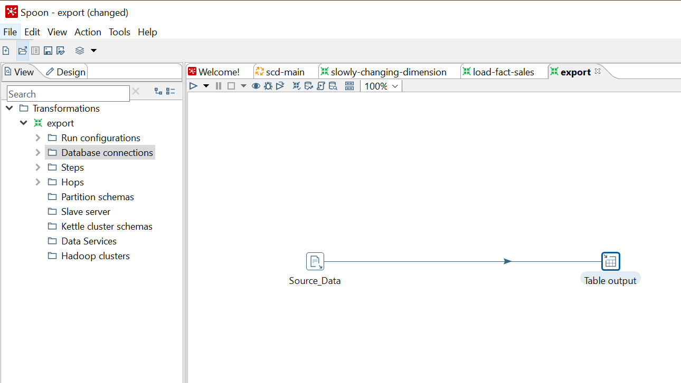
Pentaho Data Integration / Kettle is the component of Pentaho responsible for the Extract, Transform and Load (ETL) processes. ETL tools are most frequently used in data warehouse environments, PDI can also be used for other purposes like Migrating of data between applications or database

Slide 17
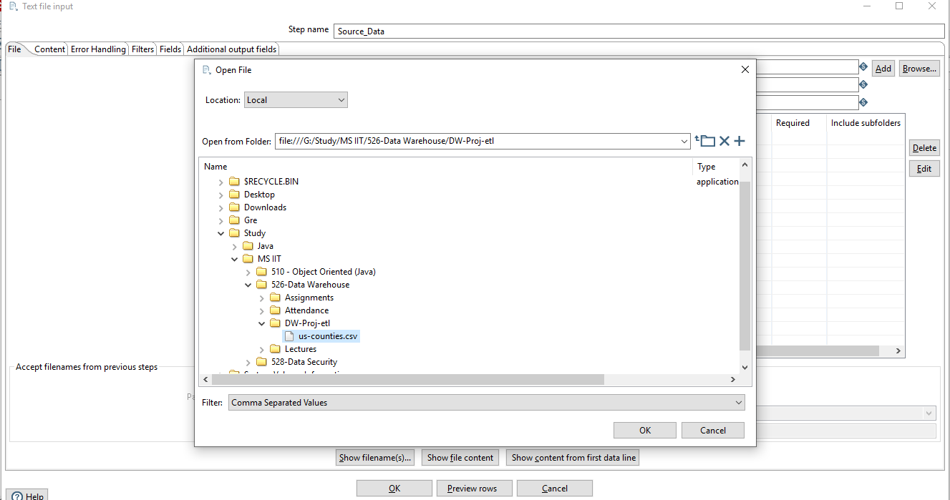
Text file input i.e. Source_Data

Slide 18
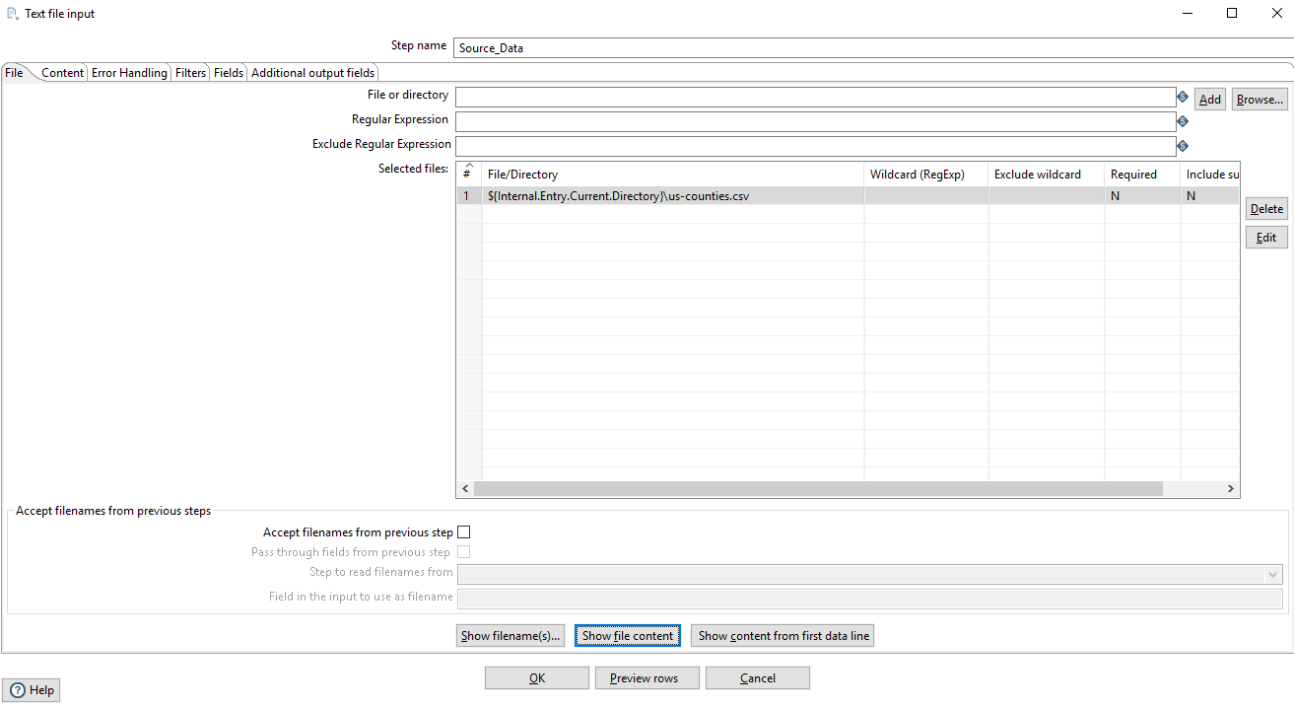
File Path replaced with internal variable

Slide 19
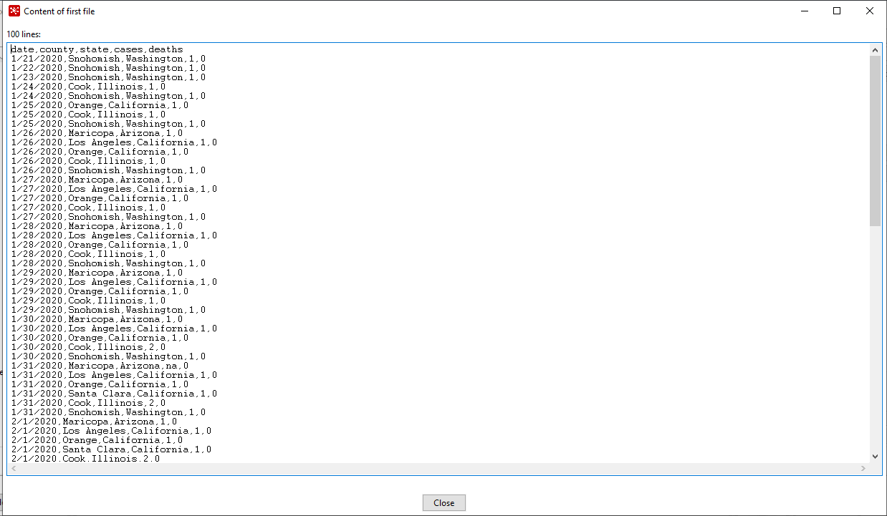
Preview if file is loaded properly

Slide 20
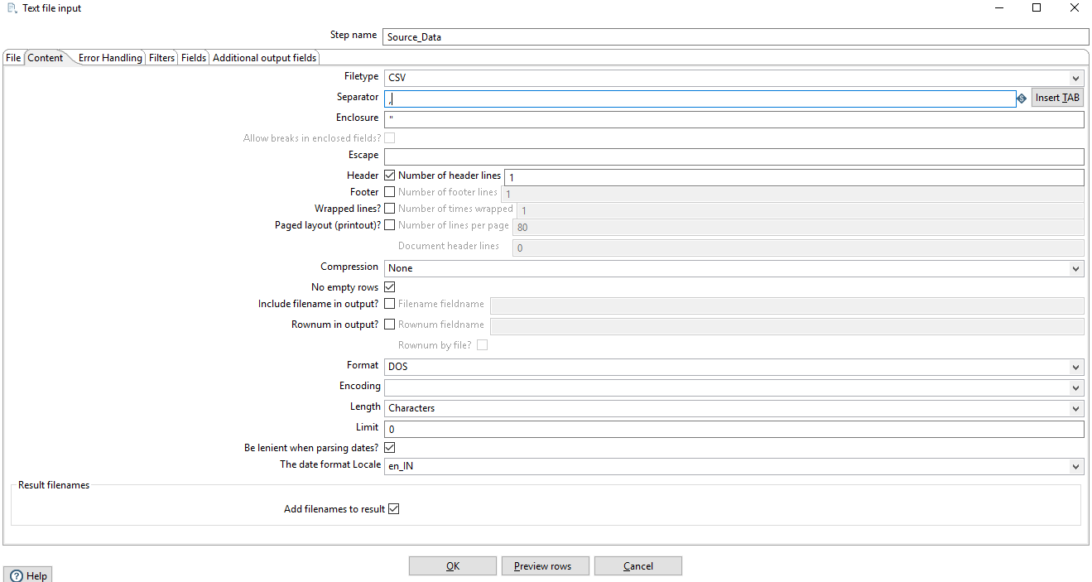
As our file is in CSV format. We need “,”as a separator.

Slide 21
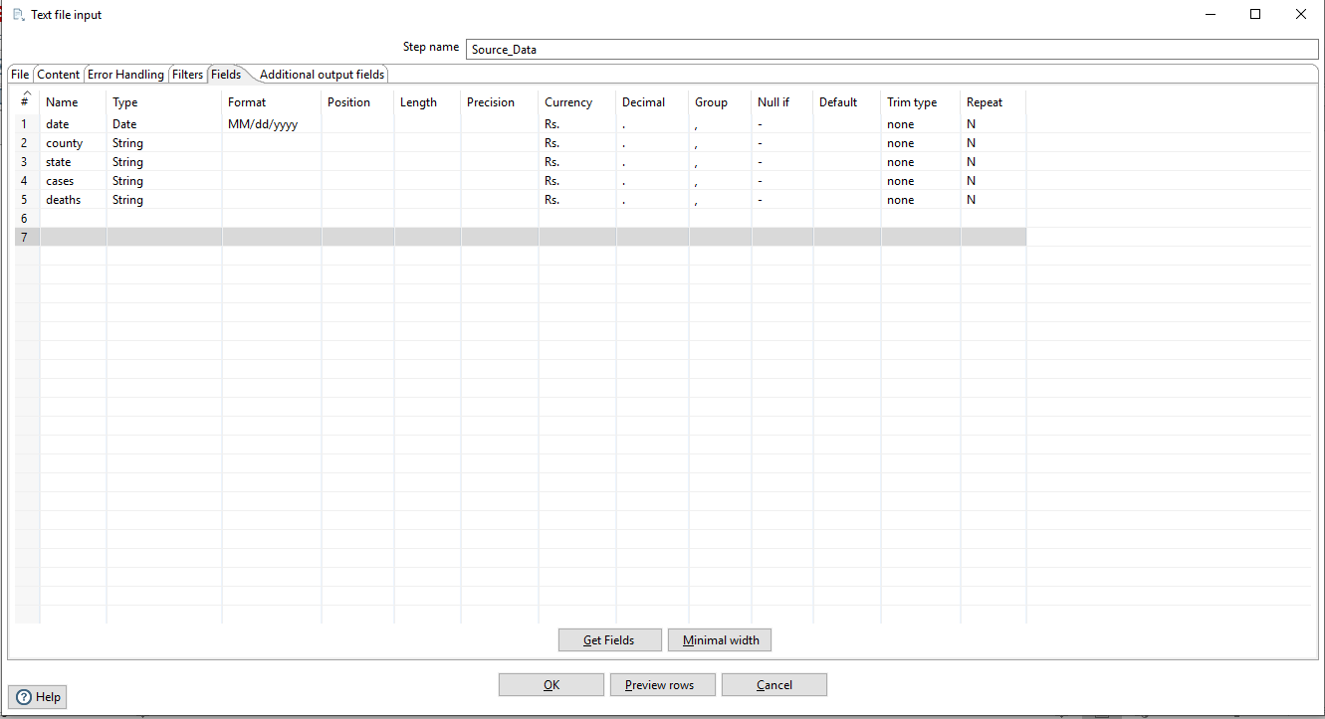
Changed format from integers to string and removed other parameters w.r.t position, length and precision.

Slide 22
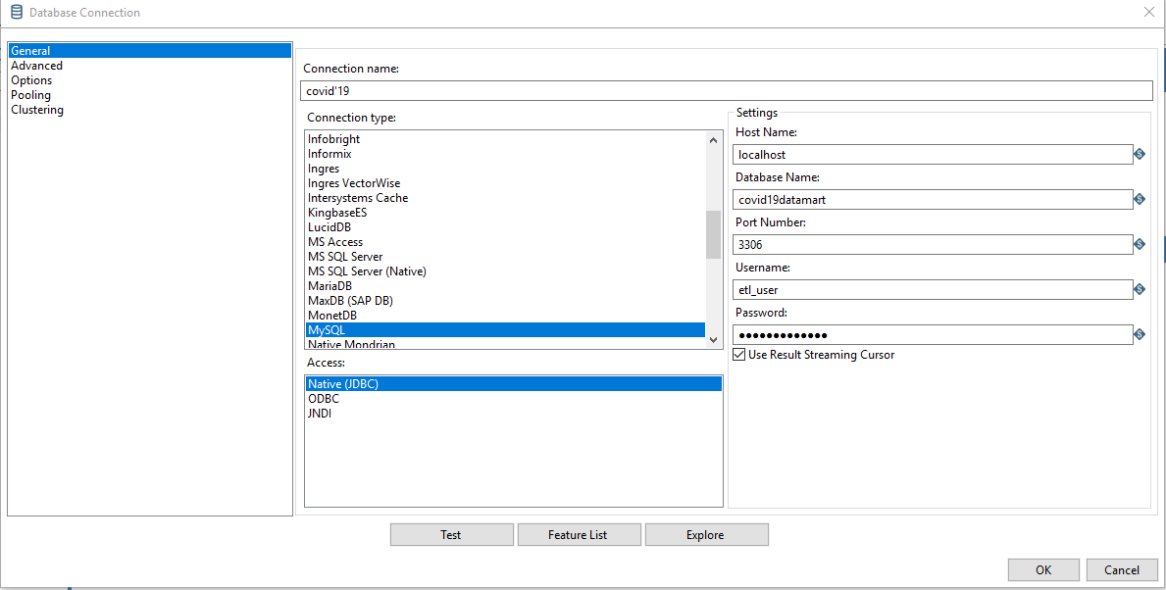
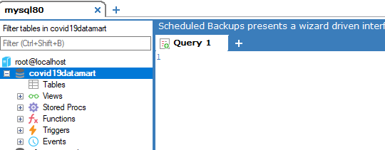
Then Created new MySQL database connection for table output and covid19datamart in SQLYog. Connection Name: covid’19 Database name: covid19datamart database.

Slide 23
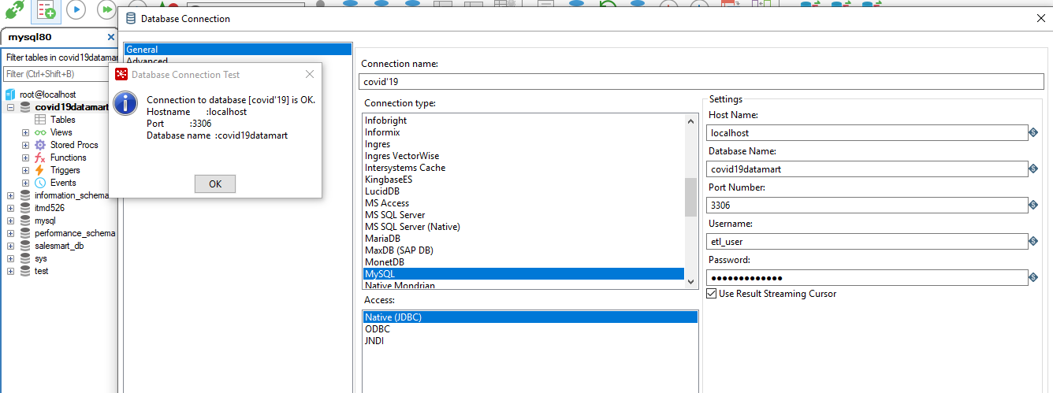
Before creating db connection we need db in SQLyog as shown: Tested Connection: OK

Slide 24
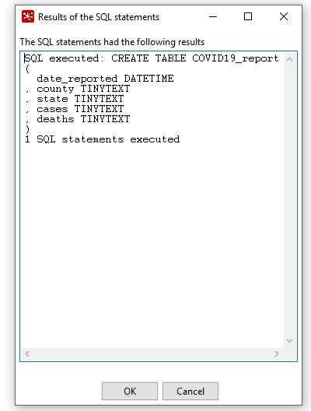
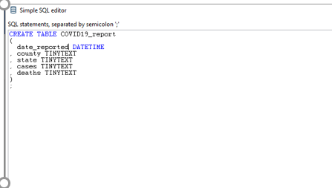
Creation of Table: covid19_report
Here, we changed date field to date_reported to avoid sql_query error.
SQL query executed successfully.

Slide 25
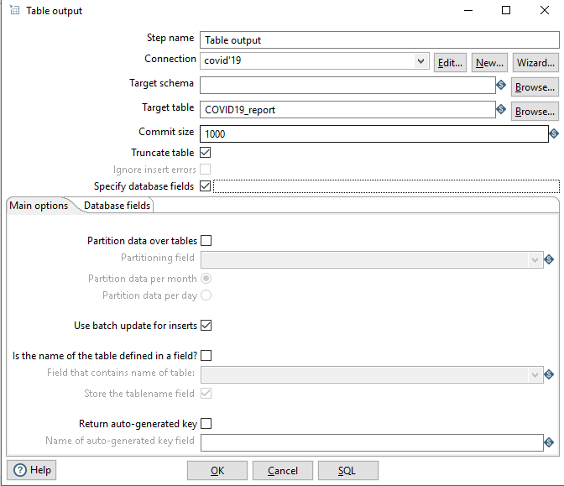
Checked Truncate Table so that every run will load fresh data.

Slide 26
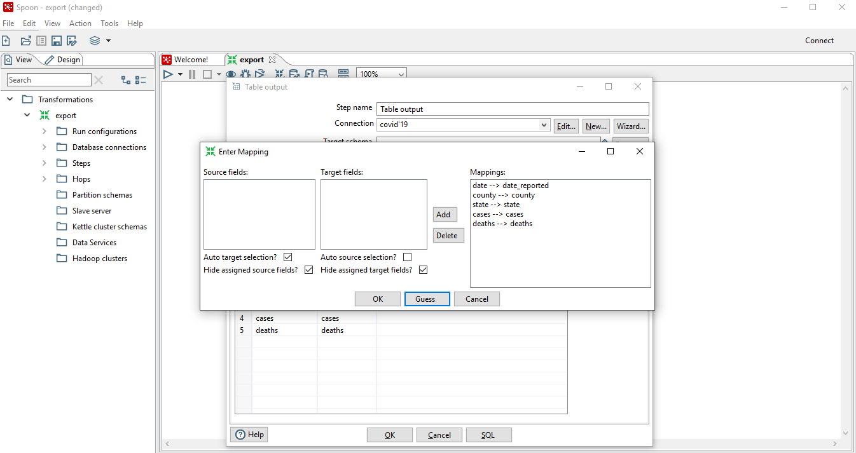
Mapped Source fields to Sql_Table fields i.e. target table “COVID19_report”

Slide 27
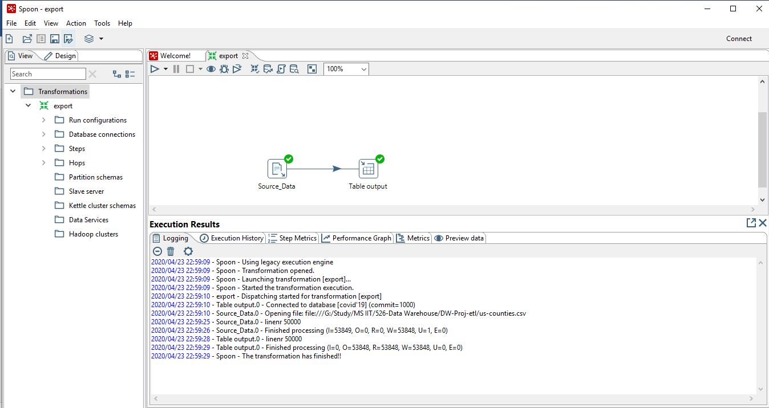
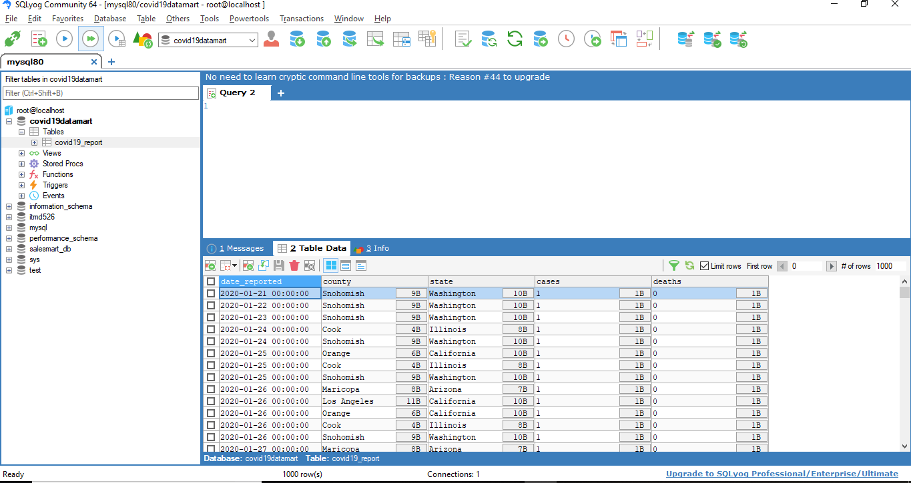
After successful run of transformation, Source data is pushed to sql table “covid19_report”

Slide 28
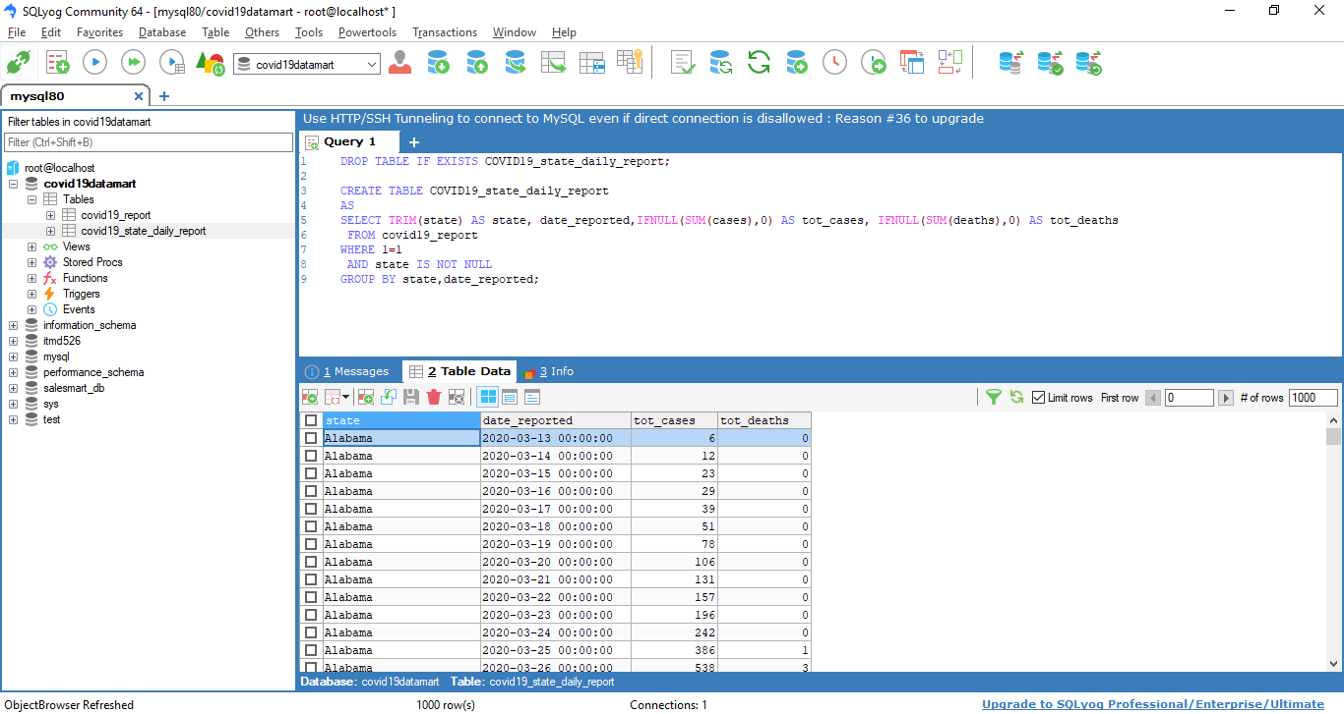
Above query will create new table “COVID19_state_daily_report” and have grouped cases/deaths according to state and date_reported to give newly_confirmed cases/deaths on daily basis

Slide 29
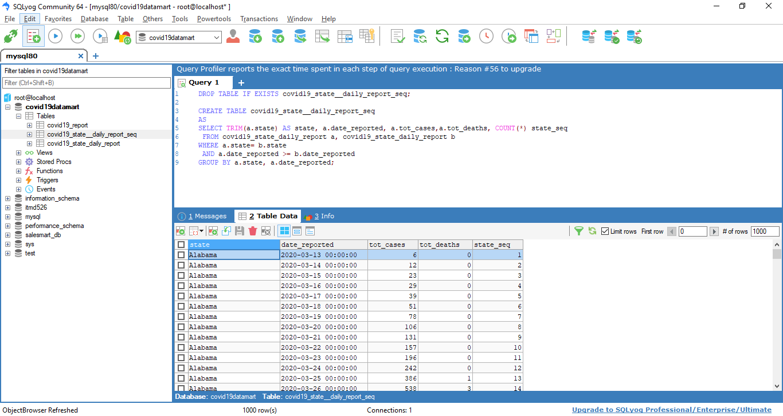
This query created state_seq column in new table “COVID19_state_seq” . This seq will be needed to obtain cumulative number of cases/deaths.

Slide 30
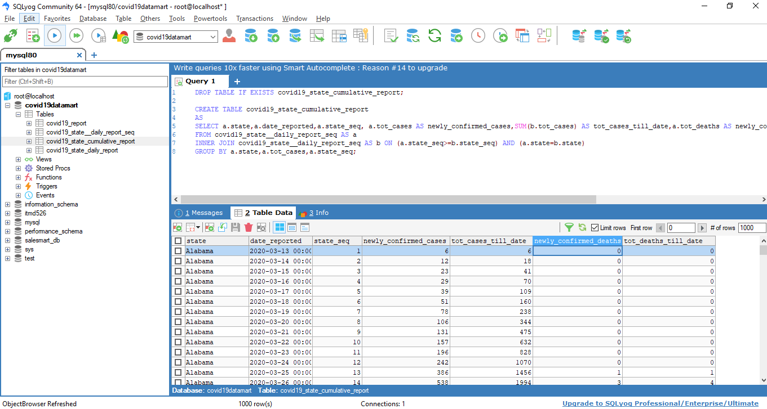
Above query created using inner join will give cumulative report i.e Total cases/deaths in till date. With this report we can analyze cumulative number of cases/deaths.

Slide 31
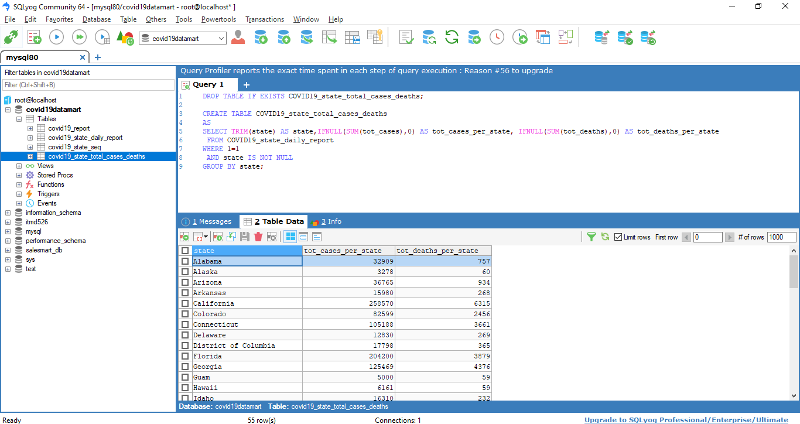
total count of cases/deaths per state

Slide 32
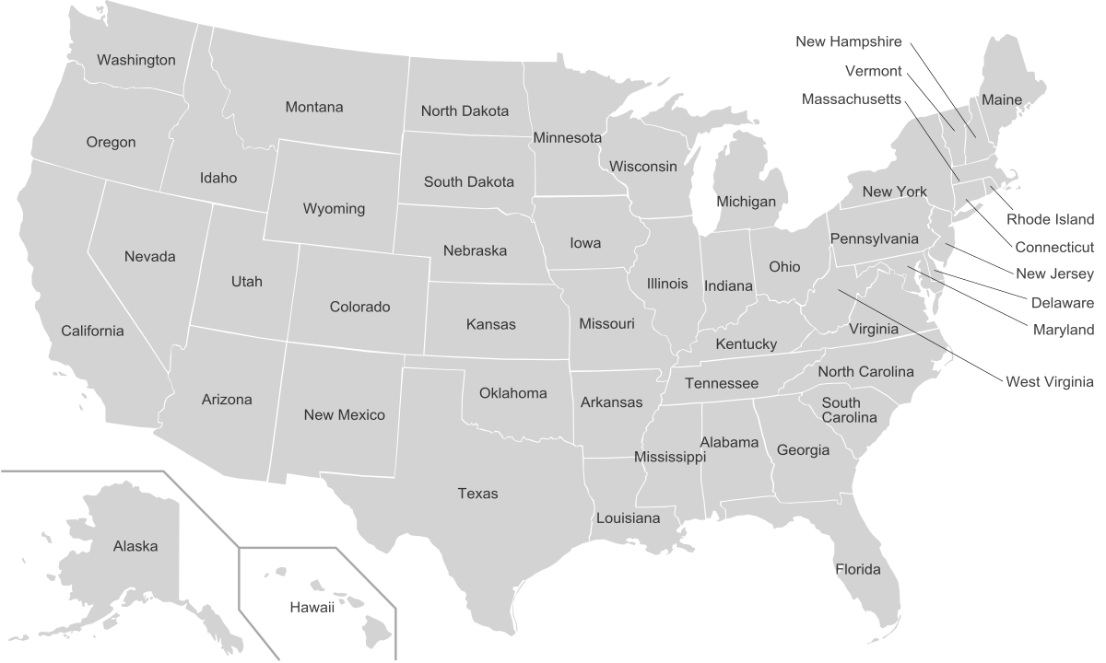
Dashboard Implementation (Visualization)

Slide 33
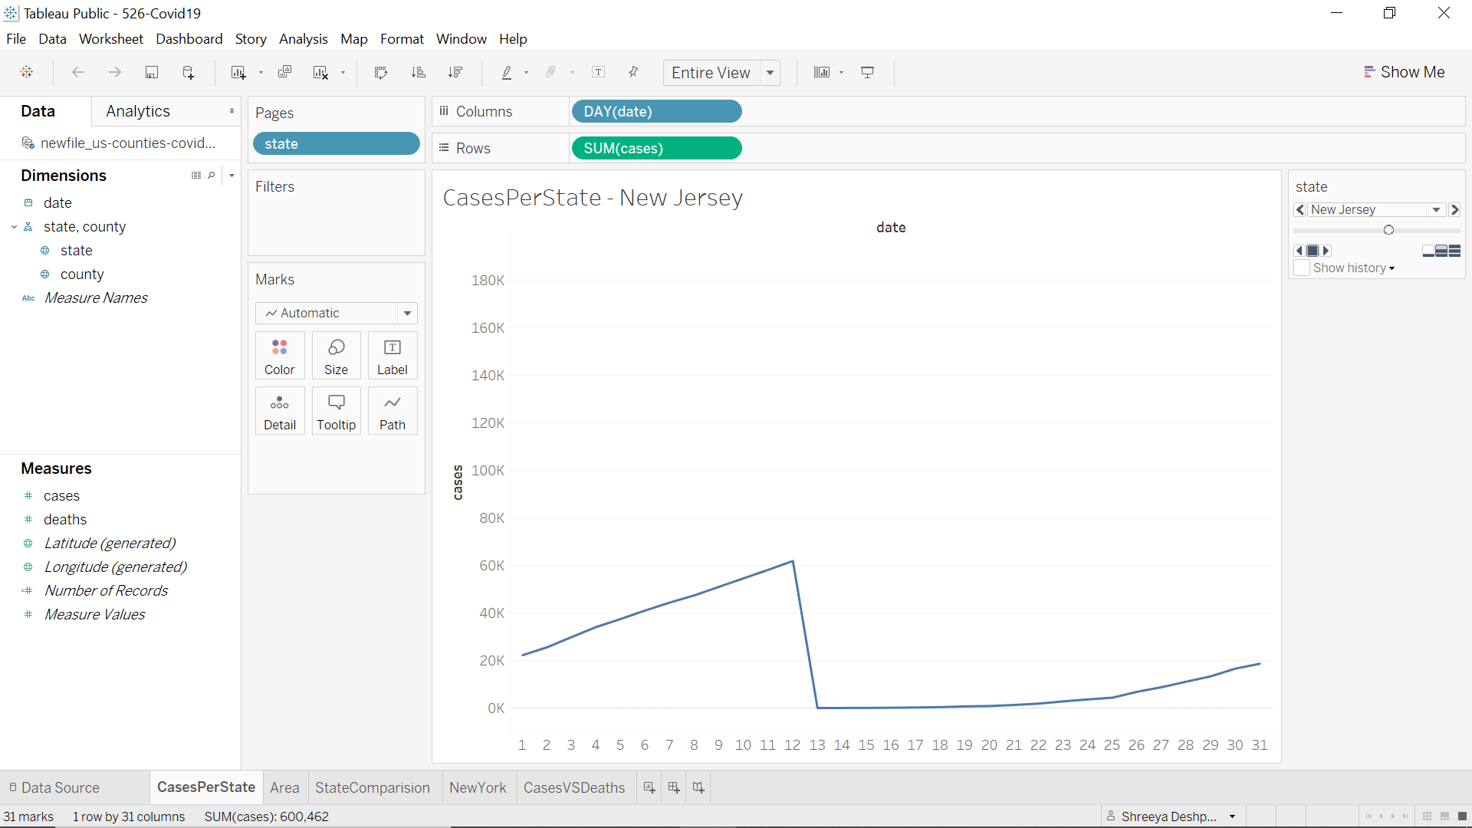
CASES PER STATE- NEW JERSEY

Slide 34
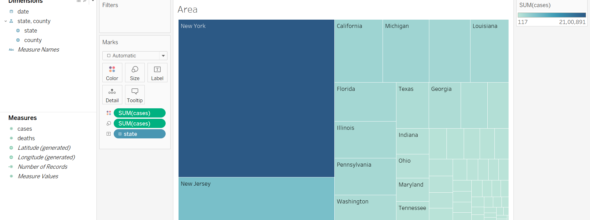
CASES AS PER STATES

Slide 35
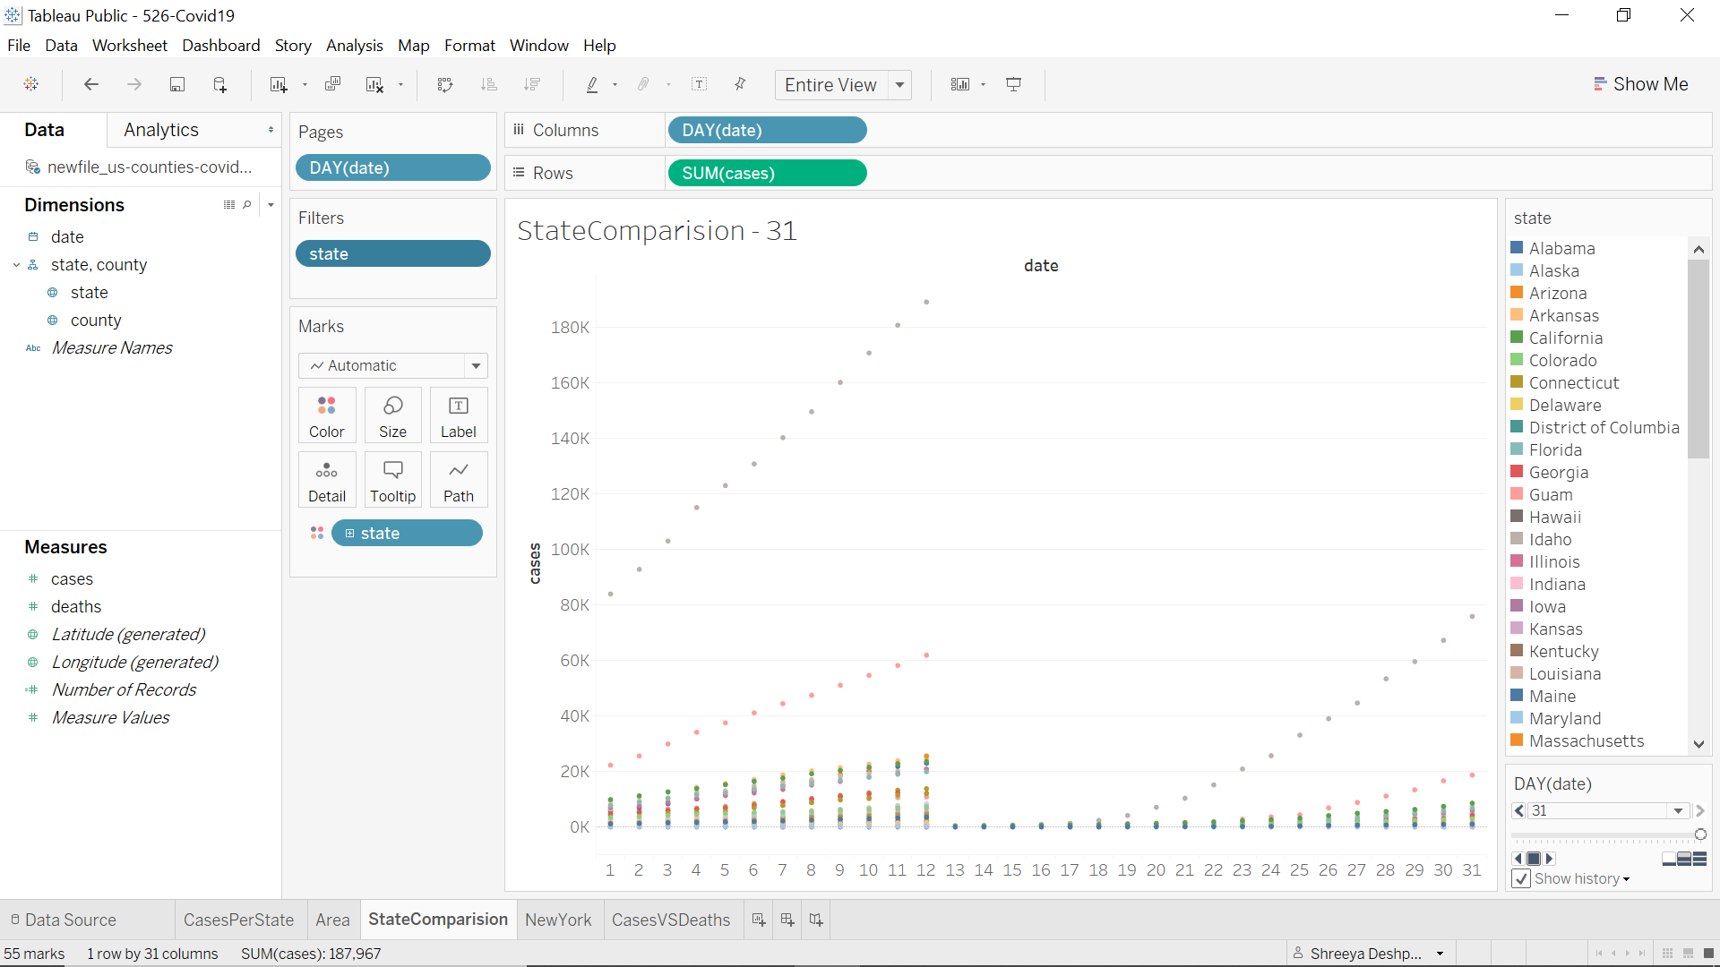
STATE WISE COMPARISON

Slide 36
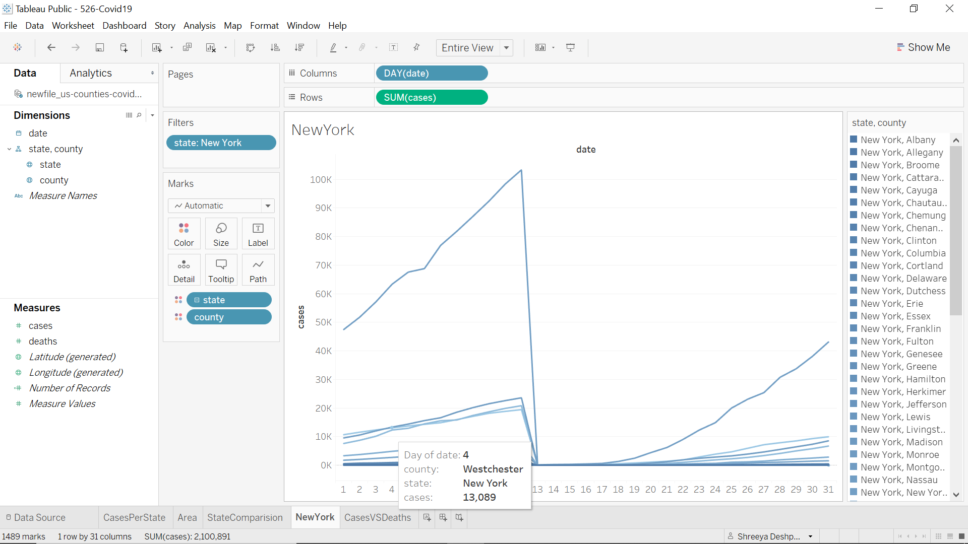
Report New York as it has most reported cases

Slide 37
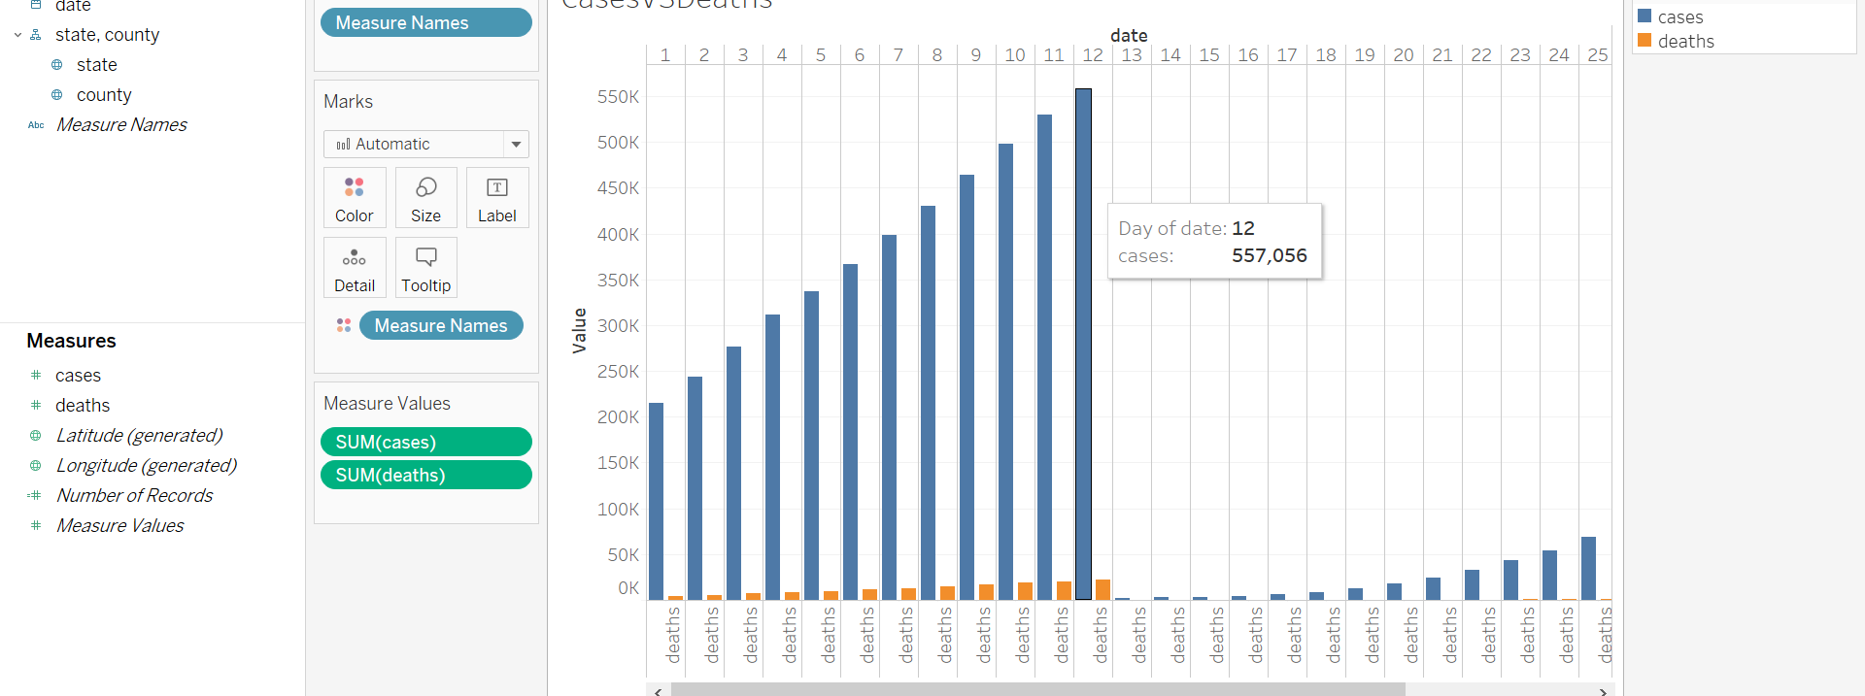
Cases vs Death Count

Slide 38
Our Analysis
Deaths across America spiked as Covid-19 began its spread, and many were never attributed to the new coronavirus. Our analysis includes the data between 21st January to12th April 2020.The data is from Kaggle website.
Notable increases in deaths were seen in March and early April. This was especially true in New York and New Jersey, states hard-hit by the pandemic. Using data from this website we found that 15,000 excess deaths from March 1 to April 4.
In the state of New York in county Westchester on day 4 we could see total 13,089 cases which are highest in comparison with all other county.
After visualizing the data, we could see the number of cases day by day.
We could measure and compare number of deaths per identified positive cases which is not too much.
That means people are recovering from this covid 19 even though the cases are increasing on daily basis

Slide 39
THANK YOU

